Slide 1
Data Analysis Project and predict Sales
Super Store Dataset

Slide 2


Agenda
Introduction and Our Goal
Correlation Analysis
Asking Questions
Preprocessing Pipline
Data Understanding
Model Selection and training
Data Cleaning
handle null values
remove outliers
check for any duplicates
Some Statistical information
EDA (Exploratory Data Analysis)
Hyperparameter tuning with GridSearch
Graphs
Data Spliting
Insights
Test the model
Dashboard
Super Store Dataset

Slide 3
Introduction and Our Goal
with growing demands and out-throat competitions in the market, a Superstore Giant is seeking our knowledge in understanding what works best for them. They would like to Understand which products, regions, categories and customer segments they target or avoid
Super Store Dataset

Slide 4
Asking questions
what are the top selling products in the superstore?
what is the sales trend over time (monthly, yearly)?
which category of products generates the highest Sales?
which region generates the most sales?
what is the average Sales for each product category?
which sub-category of products has the highest demand?
Super Store Dataset

Slide 5
Data understanding
ROW ID => Unique ID for each row
Order ID => Unique Order ID for each Customer
Order Date => Order Date of the product
Ship Date => Shipping Date of the Product
Ship Mode => Shipping Mode specified by the Customer.
Customer ID => Unique ID to identify each customer
Customer Name => Name of the Customer
Segement => The segment where the Customer belongs
Country => Country of residence of the Customer
City => City of residence of the Customer
State => State of residence of the customer
Postal Code => Postal Code of every Customer
Region => Region where the Customer belong
Super Store Dataset

Slide 6
Some statistical information
Data understanding
mode
mean
median
Super Store Dataset

Slide 7
Data Cleaning
Super Store Dataset

Slide 8
Data Cleaning
remove null values
remove outlier
check for any Duplicate values
Super Store Dataset

Slide 9
EDA
Super Store Dataset

Slide 10
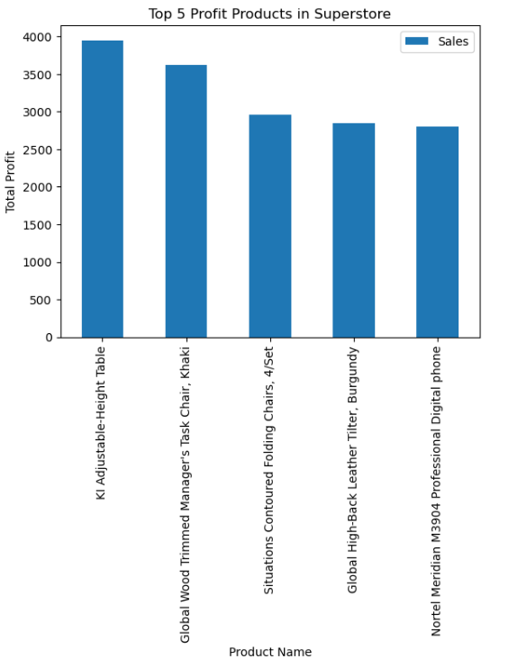
What are the top selling products in the superstore?

Slide 11
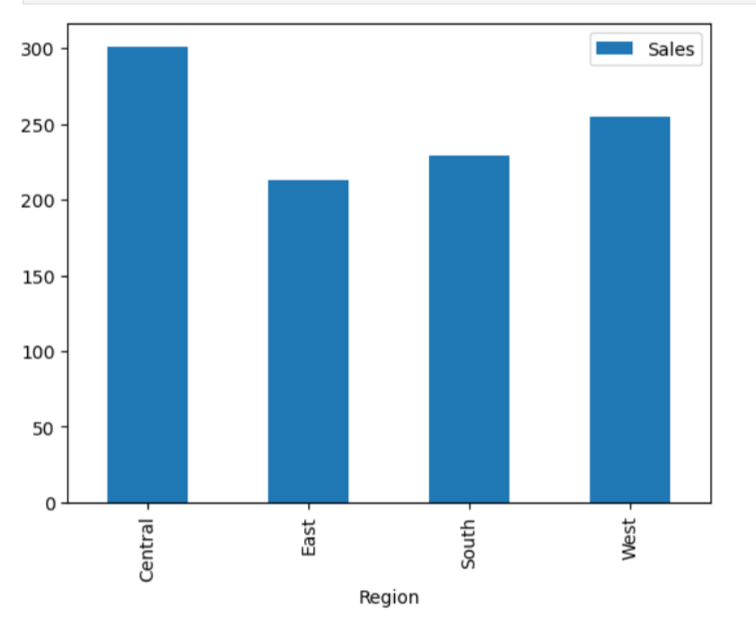
which region has
the highest sales
of
KI Adjustable-Height Table
product

Slide 12
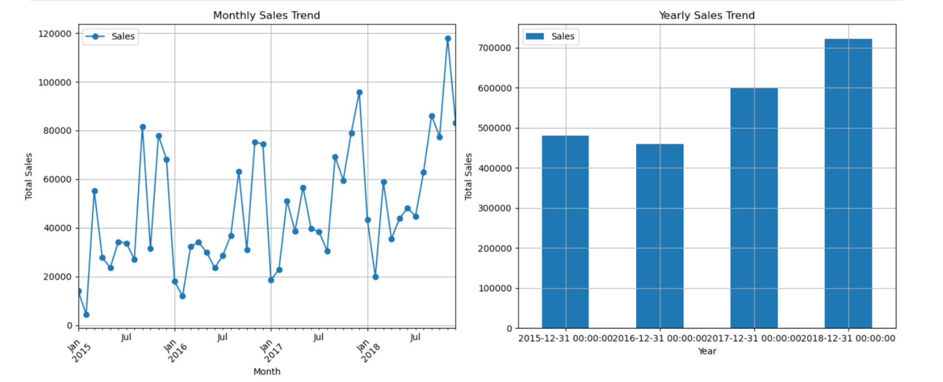
What is the sales trend over time (monthly, yearly)?

Slide 13
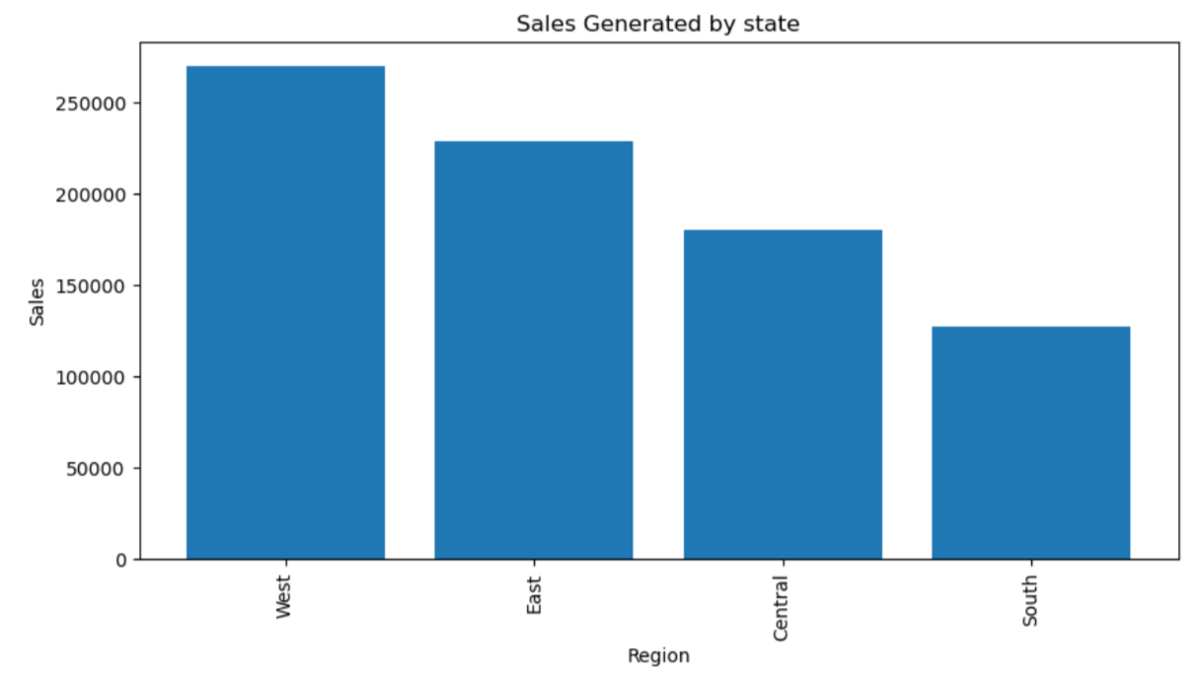
Which region & place generate the most sales?
west has the highest Sales

Slide 14
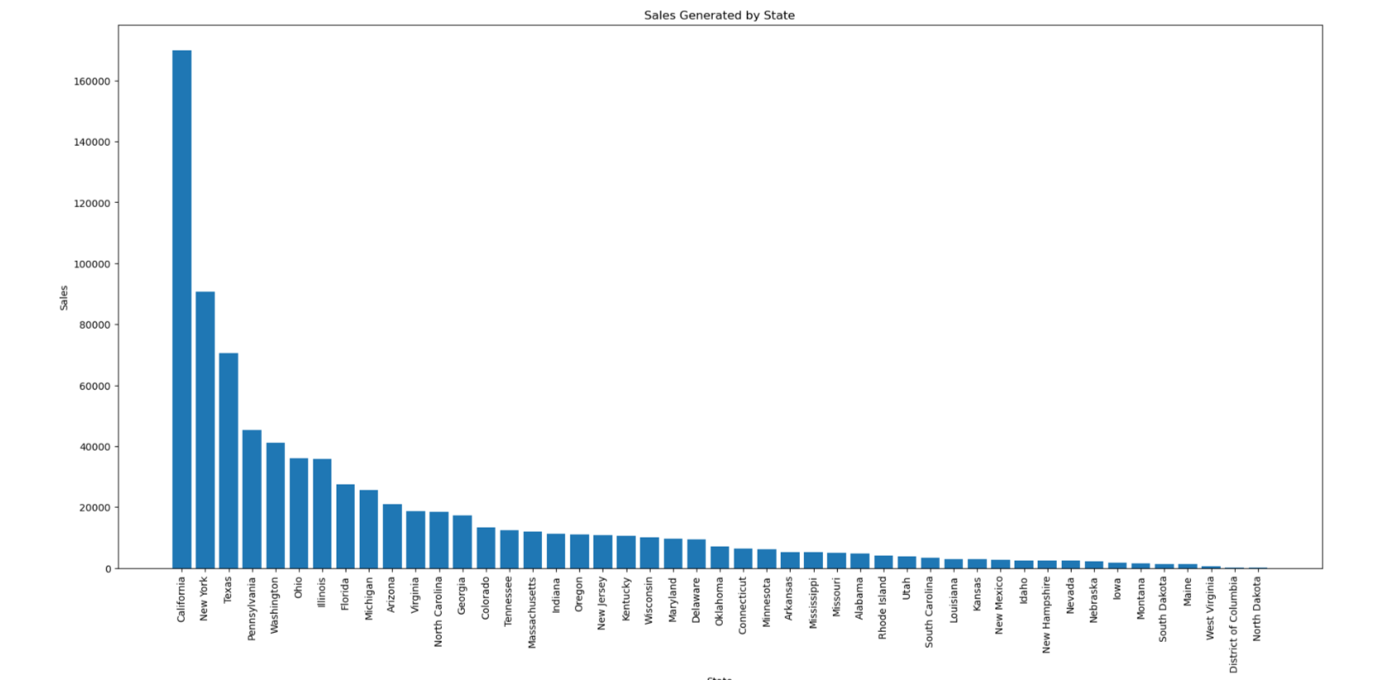
Which state has the highest sales?
california and new York
has the highest sales

Slide 15
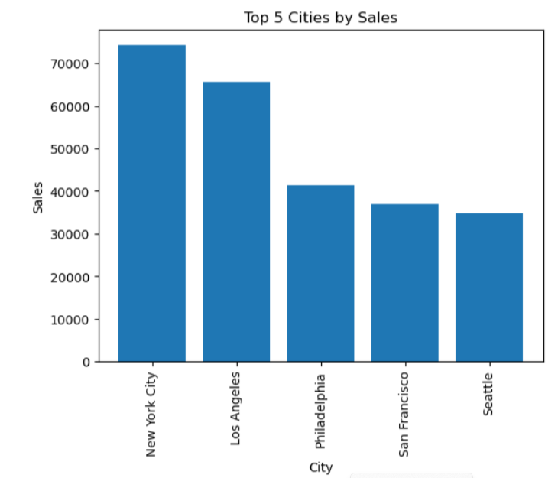
Which state has the highest sales?

Slide 16
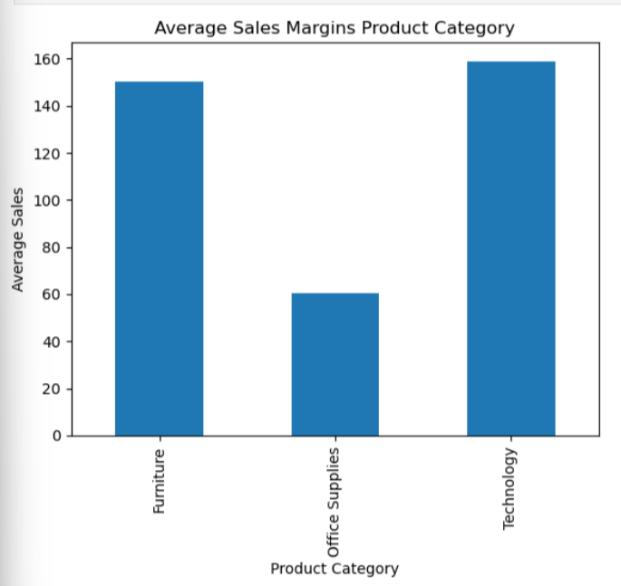
Average
Sales
On product
Category

Slide 17
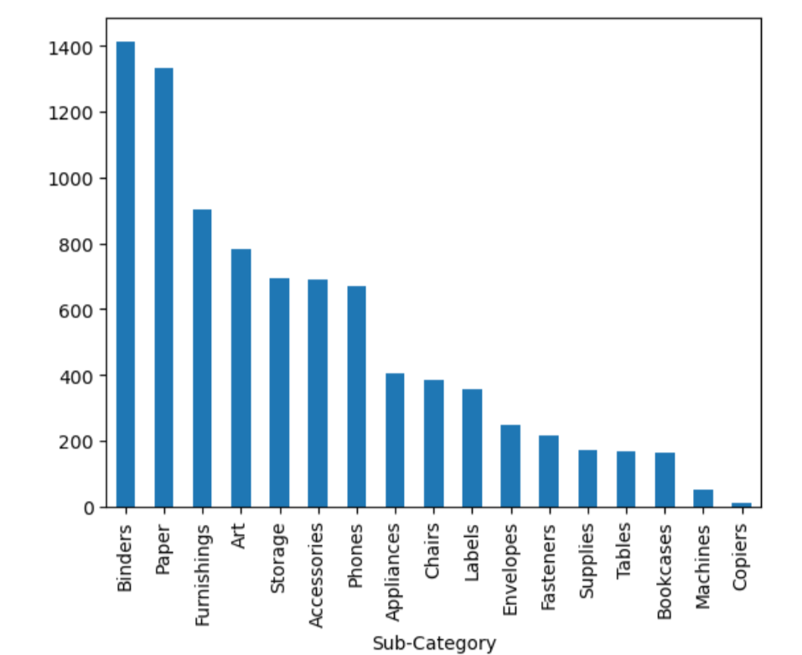
High Sales
On each SubCategory

Slide 18
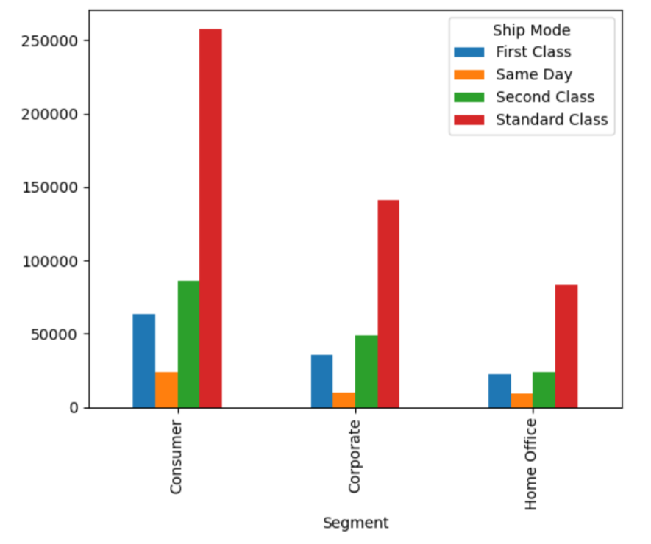
Sales between
Segments

Slide 19
Insights
Super Store Dataset

Slide 20
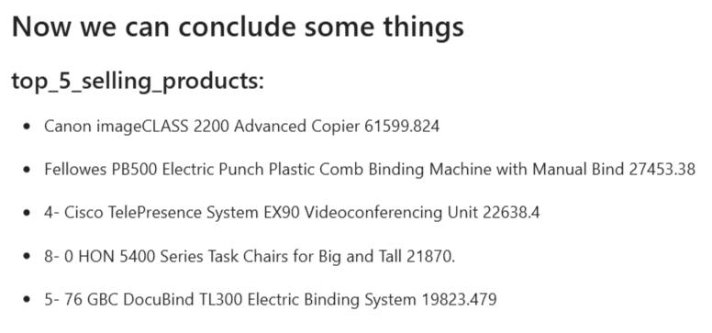

Slide 21
Model
Sales Forecasting

Slide 22

1. Import Necessary Libraries
2. Correlation Analysis
3. Preprocessing Pipeline
4. Model Selection and Training
5. Hyperparameter Tuning with Grid Search
6. Data Splitting and Model Evaluation
7.Test the model

Slide 23

Thank You

